Slide 1
CSE 205: Digital Logic Design
Dr. Tanzima Hashem
Professor
CSE, BUET

Slide 2
Textbook
Digital Design (5th Edition)
M. Morris Mano
Michael D. Ciletti

Slide 3
Digital Systems
Digital Systems
Example: digital cameras, digital telephones, digital television, digital computers…
Used in communication, business transactions, traffic control, space guidance, medical treatment, weather monitoring, the Internet …
Why study digital logic design
To design and build a digital system

Slide 4
Boolean (Binary) Logic
Deals with binary variables and binary logic functions
Binary variables has two discrete values
0, False, Open
1, True, Close
Three basic logical operations
AND (.); OR (+); NOT (‘)

Slide 5
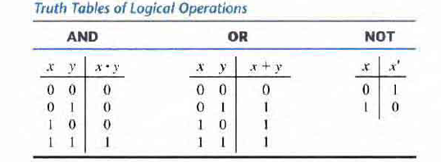
Truth Table
Specifies results for all possible input combinations

Slide 6
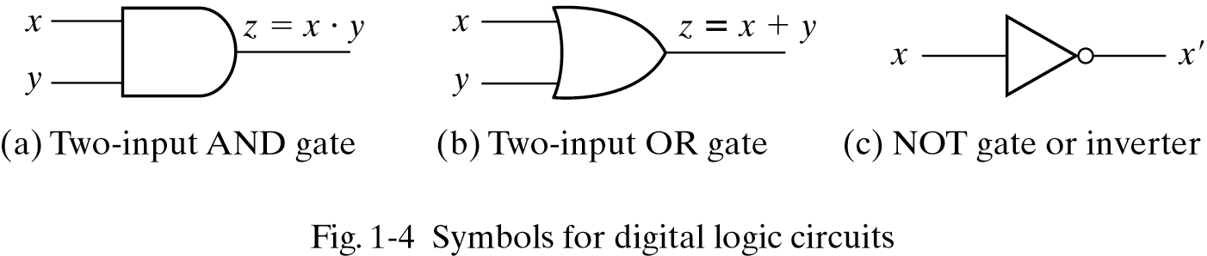
Logic Gates
Logic gates are electronic circuits that operate on one or more input signals to produce an output signal

Slide 7
Boolean Function
An algebraic expression
Binary variables
Constants 0 and 1
Logic operation symbols
f(x,y,z) = (x + y’)z + x’
Some terminology, notation and precedence:
f is the name of the function.
(x,y,z) are the input variables, each representing 1 or 0.
A literal is a single variable within a term, in complemented or uncomplemented form. The function above has four literals: x, y’, z, and x’.
Parenthesis has the highest precedence, followed by NOT, AND, and then OR.

Slide 8
Boolean Function
A Boolean function can be represented in a truth table.
f(x,y,z) = (x + y’)z + x’
f(0,0,0) = (0 + 1)0 + 1 = 1
f(0,0,1) = (0 + 1)1 + 1 = 1
f(0,1,0) = (0 + 0)0 + 1 = 1
f(0,1,1) = (0 + 0)1 + 1 = 1
f(1,0,0) = (1 + 1)0 + 0 = 0
f(1,0,1) = (1 + 1)1 + 0 = 1
f(1,1,0) = (1 + 0)0 + 0 = 0
f(1,1,1) = (1 + 0)1 + 0 = 1

Slide 9
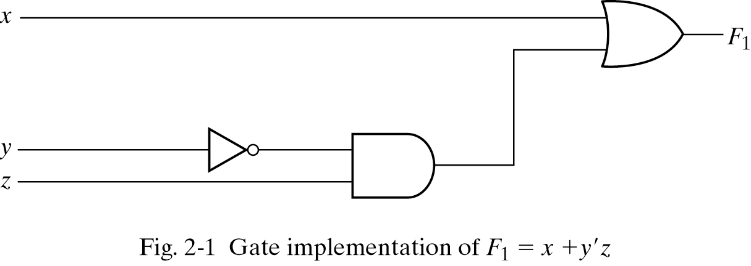
Gate Implementation of a Function

Slide 10
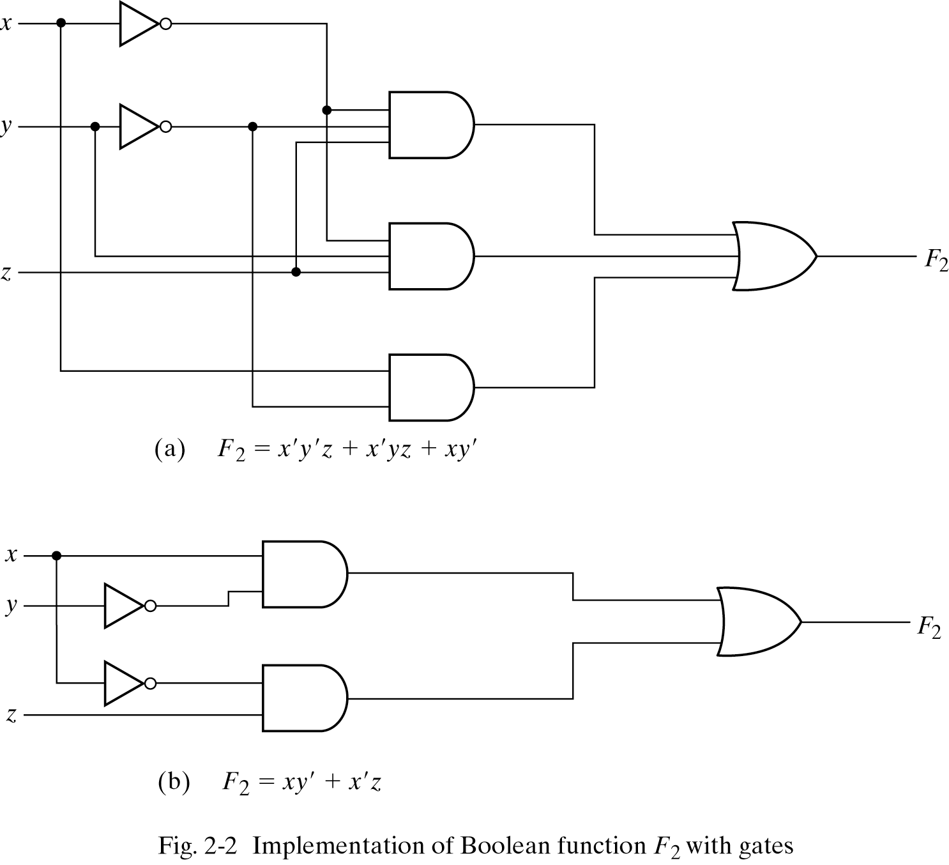
Gate Implementation of a Function

Slide 11
Boolean Algebra
Algebra for binary values
Boolean Algebra: Developed by George Boole in 1854
Why study Boolean Algebra?
To find the simplest circuit implementation with the smallest number of gates or wires
Simpler circuits are cheaper to build, consume less power, and run faster than complex circuits

Slide 12
Algebra
What is an algebra?
Mathematical system consisting of
Set of elements
Set of operators
Axioms or postulates: facts that can be taken as true; they do not require proof

Slide 13
Axiomatic definition of Boolean Algebra
A Boolean algebra requires
A set of elements B, consisting of two elements (0 and 1)
Two binary operations OR and AND
The axioms below must always be true

Slide 14
Axiomatic definition of Boolean Algebra
Based on axiom #5, we can develop a unary (one-argument) operation NOT

Slide 15
Axiomatic definition of Boolean Algebra
The distributive laws
x | y | z | y+z | x．(y+z) | x．y | x．z | (x．y)+(x．z)
0 | 0 | 0 | 0 | 0 | 0 | 0 | 0
0 | 0 | 1 | 1 | 0 | 0 | 0 | 0
0 | 1 | 0 | 1 | 0 | 0 | 0 | 0
0 | 1 | 1 | 1 | 0 | 0 | 0 | 0
1 | 0 | 0 | 0 | 0 | 0 | 0 | 0
1 | 0 | 1 | 1 | 1 | 0 | 1 | 1
1 | 1 | 0 | 1 | 1 | 1 | 0 | 1
1 | 1 | 1 | 1 | 1 | 1 | 1 | 1

Slide 16
Duality principle
If an expression is valid in Boolean algebra, the dual of that expression is also valid
To form the dual of an expression, replace
all + operators with . operators,
all . operators with + operators,
all ones with zeros, and
all zeros with ones
Form the dual of the expression
a + (bc) = (a + b)(a + c)
Following the replacement rules…
a(b + c) = ab + ac

Slide 17
Duality principle
The left and right columns of axioms are duals
exchange all ANDs with ORs, and 0s with 1s

Slide 18
Basic theorems of Boolean Algebra
In addition to the axioms, additional laws can be derived; they are called theorems of Boolean Algebra
These theorems are useful in performing algebraic manipulations of Boolean expressions

Slide 19
Proof of x+x=x
We can only use Huntington postulates:
Show that x+x=x.
x+x = (x+x)·1 by 2(b)
= (x+x)(x+x’) by 5(a)
= x+xx’ by 4(b)
= x+0 by 5(b)
= x by 2(a)
We can now use Theorem 1(a) in future proofs
Post. 2: (a) x+0=x, (b) x·1=x
Post. 3: (a) x+y=y+x, (b) x·y=y·x
Post. 4: (a) x(y+z) = xy+xz, (b) x+yz = (x+y)(x+z)
Post. 5: (a) x+x’=1, (b) x·x’=0

Slide 20
Proof of x·x=x
Similar to previous proof
Show that x·x = x.
x·x = xx+0 by 2(a)
= xx+xx’ by 5(b)
= x(x+x’) by 4(a)
= x·1 by 5(a)
= x by 2(b)
Post. 2: (a) x+0=x, (b) x·1=x
Post. 3: (a) x+y=y+x, (b) x·y=y·x
Post. 4: (a) x(y+z) = xy+xz, (b) x+yz = (x+y)(x+z)
Post. 5: (a) x+x’=1, (b) x·x’=0
Th. 1: (a) x+x=x

Slide 21
Proof of x+1=1
Theorem 2(a): x + 1 = 1
x + 1 = 1．(x + 1) by 2(b)
=(x + x')(x + 1) 5(a)
= x + x' 1 4(b)
= x + x' 2(b)
= 1
Theorem 2(b): x．0 = 0 by duality
Theorem 4: (x')' = x
Postulate 5 defines the complement of x, x + x' = 1 and x x' = 0
The complement of x' is x is also (x')'
Post. 2: (a) x+0=x, (b) x·1=x
Post. 3: (a) x+y=y+x, (b) x·y=y·x
Post. 4: (a) x(y+z) = xy+xz, (b) x+yz = (x+y)(x+z)
Post. 5: (a) x+x’=1, (b) x·x’=0
Th. 1: (a) x+x=x, (b) x.x =x

Slide 22
Absorption Property (Covering)
Theorem 6(a): x + xy = x
x + xy = x．1 + xy by 2(b)
= x (1 + y) 4(a)
= x (y + 1) 3(a)
= x．1 Th 2(a)
= x 2(b)
Theorem 6(b): x (x + y) = x by duality
By means of truth table (another way to proof )
Post. 2: (a) x+0=x, (b) x·1=x
Post. 3: (a) x+y=y+x, (b) x·y=y·x
Post. 4: (a) x(y+z) = xy+xz, (b) x+yz = (x+y)(x+z)
Post. 5: (a) x+x’=1, (b) x·x’=0
Th. 1: (a) x+x=x, (b) x.x =x
Th. 2: (a) x + 1 = 1, (b) x.0 =0

Slide 23
Absorption Property (Covering)
Theorem 6(a): x + xy = x
x | y | xy | x+xy
0 | 0 | 0 | 0
0 | 1 | 0 | 0
1 | 0 | 0 | 1
1 | 1 | 1 | 1

Slide 24
DeMorgan’s Theorem
Theorem 5(a): (x + y)’ = x’y’
Theorem 5(b): (xy)’ = x’ + y’
By means of truth table
x | y | x’ | y’ | x+y | (x+y)’ | x’y’ | xy | x’+y' | (xy)’
0 | 0 | 1 | 1 | 0 | 1 | 1 | 0 | 1 | 1
0 | 1 | 1 | 0 | 1 | 0 | 0 | 0 | 1 | 1
1 | 0 | 0 | 1 | 1 | 0 | 0 | 0 | 1 | 1
1 | 1 | 0 | 0 | 1 | 0 | 0 | 1 | 0 | 0

Slide 25
Consensus Theorem
xy + x’z + yz = xy + x’z
(x+y)•(x’+z)•(y+z) = (x+y)•(x’+z) -- (dual)
Proof: xy + x’z + yz = xy + x’z + (x+x’)yz = xy + x’z + xyz + x’yz = (xy + xyz) + (x’z + x’zy)
= xy(1+z) + x’z (1+y) = xy + x’z

Slide 26
Gate Implementation of a Function
F₂=x’y’z + x’yz + xy’ = x’z(y’+y) + xy’ = x’z +xy’

Slide 27
Gate Implementation of a Function

Slide 28
Practice
Simplify the following Boolean expressions to a minimum number of literals:
xyz + x'y + xyz’
(A + B)'(A' + B') '
xyz + x'y + xyz' = xy(z + z') + x'y = xy + x'y = y
(A + B)'(A' + B')' = (A'B')(A B) = 0

Slide 29
Complement of a Function
Applying DeMorgan’s theorems:
f(x,y,z) = x(y’z’ + yz)
f ’(x,y,z) = (x(y’z’ + yz))’ [ complement both sides ]
= x’ + (y’z’ + yz)’ [ because (xy)’ = x’ + y’ ]
= x’ + (y’z’)’ (yz)’ [ because (x + y)’ = x’ y’ ]
= x’ + (y + z)(y’ + z’) [ because (xy)’ = x’ + y’, twice]

Slide 30
Complement of a Function
The complement of a function always outputs 0 where the original function outputted 1, and 1 where the original produced 0
f(x,y,z) = (x + y’)z + x’

Slide 31
Complement of a Function
By taking the dual of f and complementing each literal:
If f(x,y,z) = x(y’z’ + yz)…
…the dual of f is x + (y’ + z’)(y + z)…
…then complementing each literal gives
x’ + (y + z)(y’ + z’)…
…so f’(x,y,z) = x’ + (y + z)(y’ + z’)

Slide 32
Practice
Find the complement of the following expressions:
xy' + x'y
[(x' + y + z')(x + y')(x + z)]
F' = (xy' + x'y)'
= (xy')'(x'y)'
= (x' + y)(x + y')
= xy + x'y‘
F' = [(x' + y + z')(x + y')(x + z)]'
= (x' + y + z')' + (x + y')' + (x + z)'
= xy'z + x'y + x'z'

Slide 33
Generalized DeMorgan’s Theorem
(A + B + C)’ = (A + x)’ let B + C = x
= A’x’
= A’ (B + C)’
= A’ (B’C’)
= A’B’C’
Complement of a function is obtained
Interchanging AND and OR operators
Complementing each literal

Slide 34
Minterms
A minterm is an AND term in which every variable or its complement occurs once
F(x,y) has 4 minterms x’y’, x’y, xy’, xy
An n variable function has 2^{n} valid minterms
A minterm equals 1 at exactly one input combination and is equal to 0 otherwise
Example: x’y’z’ = 1 only when x=0, y=0, z=0

Slide 35
Maxterms
A maxterm is an OR term in which every variable or its complement occurs once
F(x,y) has 4 maxterms x’+y’, x’+y, x+y’, x+y
An n variable function has 2^{n} valid maxterms
A maxterm equals 0 at exactly one input combination and is equal to 1 otherwise
Example: (x+y+z) = 0 only when x=0, y=0, z=0

Slide 36
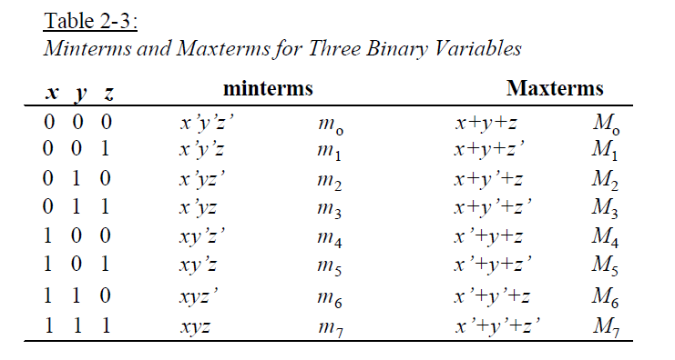
Example: Three Binary Variables

Slide 37
Canonical Form
Any boolean function that is expressed as a sum of minterms or as a product of maxterms is said to be in its canonical form.

Slide 38
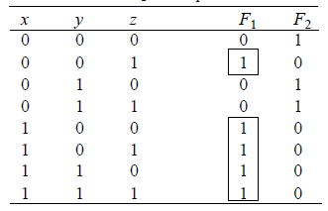
Sum of Minterms
F₁(x, y, z) = ∑(1,4,5,6,7) = m₁ + m₄ + m₅ + m₆ + m₇
=x' y' z + xy' z’ + xy' z + xyz’ + xyz

Slide 39
Sum of Minterms: Example
F = x + yz
= x(y + y’)(z + z’) + (x + x’)yz = xyz + xyz’ + xy’z + xy’z’ + xyz + x’yz = x’yz + xy’z’ + xy’z + xyz’ + xyz = Σ(3,4,5,6,7)
Or convert the expression into truth-table and then read the minterms from the table

Slide 40
Product of Maxterms
A Boolean function can be expressed algebraically from a given truth table
by forming a maxterm for each combination of the variables that produces a 0 in the function, and
then taking the AND of all those maxterms.

Slide 41
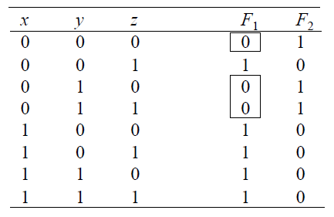
Product of Maxterms
F₁(x, y, z) = ∏(0,2,3) = M₀ ×M₂ ×M₃
= (x + y + z)(x + y'+z)(x + y'+z')

Slide 42
Product of Maxterms: Example
F = xy + x’z = (xy+x’)(xy+z)
= (x+x’)(y+x’)(x+z)(y+z) = (x’+y)(x+z)(y+z)
x’+y = x’+y+zz’ = (x’+y+z)(x’+y+z’)
x+z = x+z+yy’ = (x+y+z)(x+y’+z)
y+z = y+z+xx ’ = (x+y+z)(x ’+y+z)
F =(x+y+z)(x+y’+z)(x’+y+z)(x’+y+z’)
=M₀M₂M₄M₅= ∏(0, 2, 4,5)
Or convert the expression into truth-table and then read the maxterms from the table

Slide 43
Conversion between Canonical Forms
Conversion between minterms and maxterms
m₀ = x’y’z’ = (x+y+z)’ = (M₀)’
In general, m_{i} = (M_{i})’
Sum of minterms → Product of maxterms:
f = Σ(0,1,2,3,6)
f’= Σ(4,5,7) = m₄ + m₅ + m₇
(f’)’= (m₄ + m₅ + m₇)’
f = m₄’ m₅’ m₇’ [DeMorgan’s law]
= M₄ M₅ M₇ = ∏(4,5,7)

Slide 44
Conversion between Canonical Forms
In general, to convert from one canonical form to another, interchange the symbols Σ and ∏ and list those numbers missing from the original form.
Example: f = Σ(0,1,2,3,6) = ∏(4,5,7)

Slide 45
Practice
Express the following function (four variables: A, B, C, D) as a sum of minterms and as a product of maxterms:
F = B'D + A'D + BD
F = ∑(1, 3, 5, 7, 9, 11,13, 15)
= ∏(0, 2, 4, 6, 8, 10, 12, 14)

Slide 46
Standard Form
Any boolean function that is expressed as a sum of products (SOP) or as a product of sums (POS), where each product-term or sum-term may contain one, two, or any number of variables, is said to be in its standard form.
SOP: f(x,y,z) = xy + x’yz + xy’z
POS: f(x,y,z) = (x’ + y’)(x + y’ + z’)(x’ + y + z’)

Slide 47
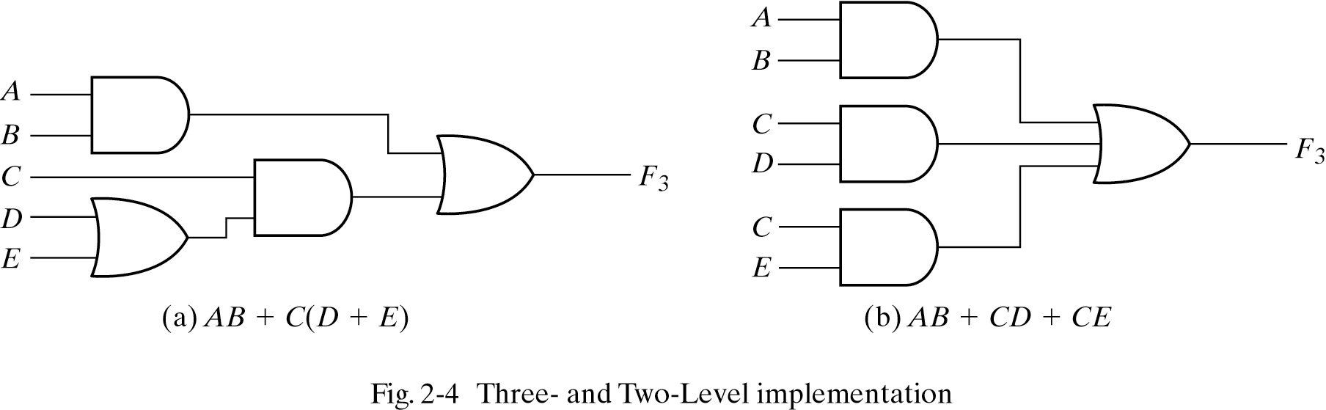
Non-Standard and Standard Forms

Slide 48
Practice
Convert the following expression into sum of products and product of sums:
(AB + C)(B + C'D)
(AB + C)(B + C'D)
= AB + BC + ABC'D + CC'D
= AB(1 + C'D) + BC
= AB + BC (SOP form)
= B(A + C) (POS form)

Slide 49
Canonical and Standard Forms
Canonical forms
Sum of minterms (SOM)
Product of maxterms (POM)
Standard forms (may use less gates)
Sum of products (SOP)
Product of sums (POS)
F = ab+a’ (already sum of products:SOP)
F = ab + a’(b+b’) (expanding term)
F = ab + a’b + a’b’ (it is canonical form:SOM)

Slide 50
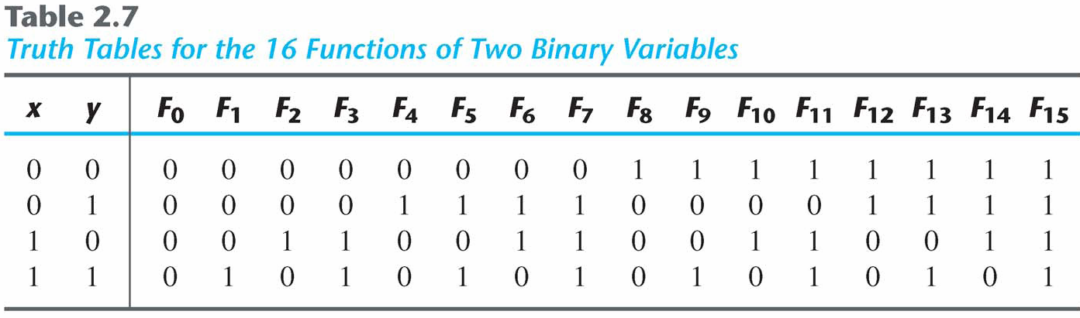
Other Logic Operations
2^{n} rows in the truth table of n binary variables.
2^{2^n} functions for n binary variables.
16 functions of two binary variables.

Slide 51
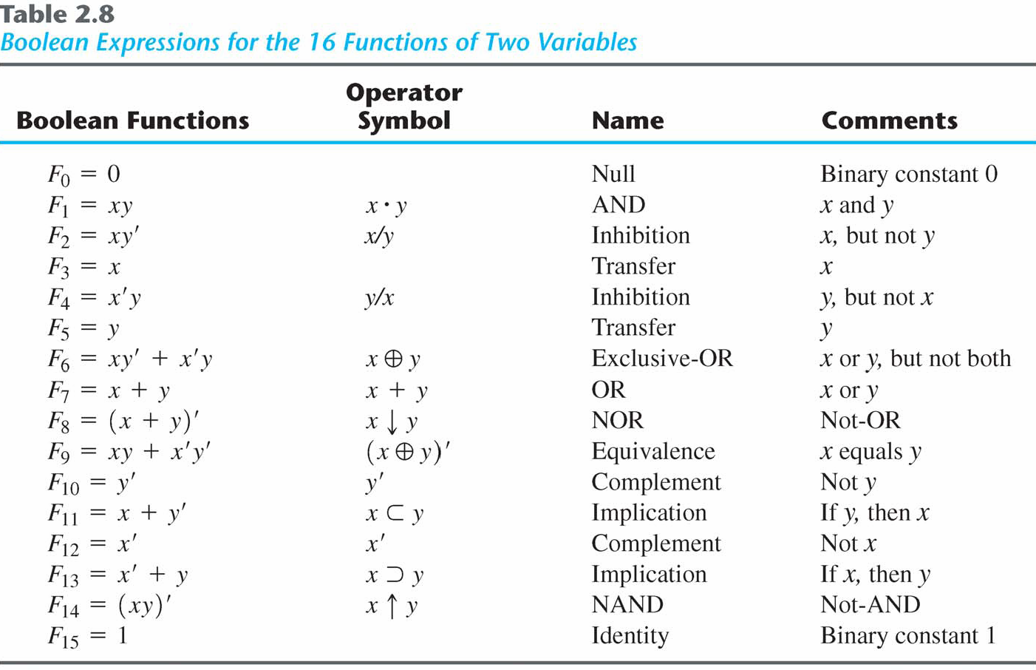
Boolean Expressions

Slide 52
Digital Logic Gates
Boolean expression: AND, OR and NOT operations
Constructing gates of other logic operations
The feasibility and economy;
The possibility of extending gate's inputs;
The basic properties of the binary operations (commutative and associative);
The ability of the gate to implement Boolean functions.

Slide 53
Summary of Logic Gates
Figure 2.5 Digital logic gates

Slide 54
Summary of Logic Gates
Figure 2.5 Digital logic gates

Slide 55
Multiple Inputs
Extension to multiple inputs
A gate can be extended to multiple inputs.
If its binary operation is commutative and associative.
AND and OR are commutative and associative.
OR
x+y = y+x
(x+y)+z = x+(y+z) = x+y+z
AND
xy = yx
(x y)z = x(y z) = x y z

Slide 56
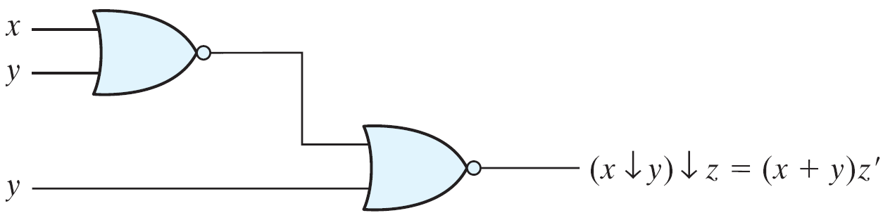
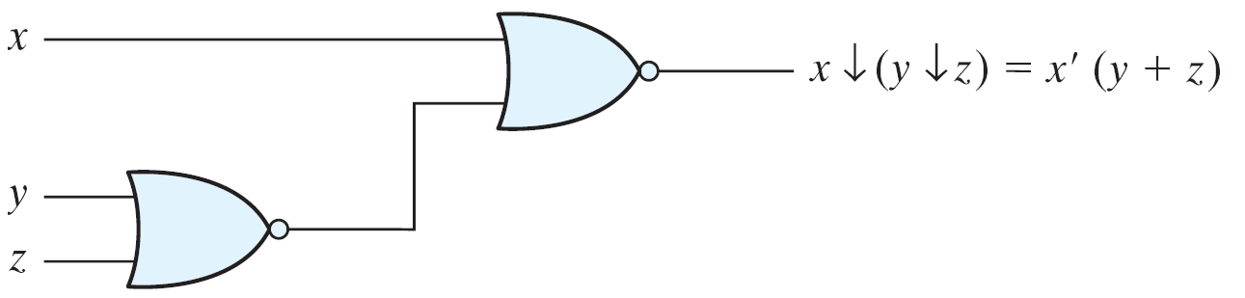
Multiple Inputs
NAND and NOR are commutative but not associative → they are not extendable.

Slide 57
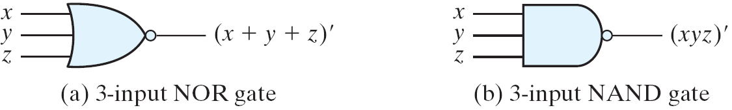
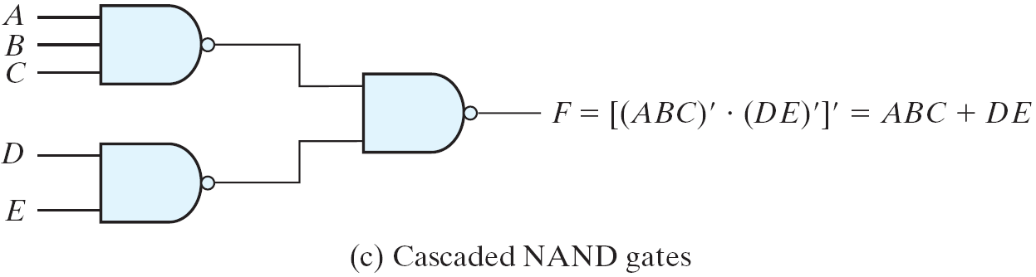
Multiple Inputs
Multiple NOR = a complement of OR gate, Multiple NAND = a complement of AND.
The cascaded NAND operations = sum of products.
The cascaded NOR operations = product of sums.

Slide 58
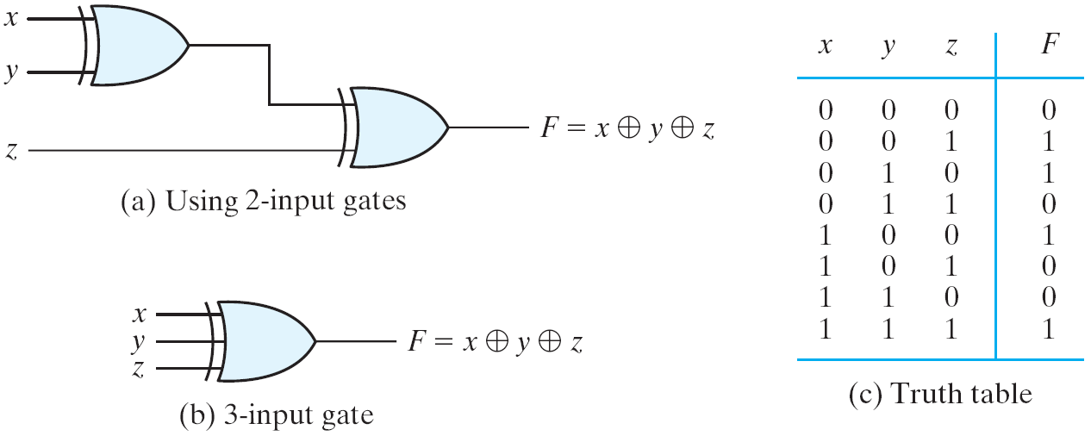
Multiple Inputs
The XOR and XNOR gates are commutative and associative.
Multiple-input XOR gates are uncommon
XOR is an odd function: it is equal to 1 if the inputs variables have an odd number of 1's.

Slide 59
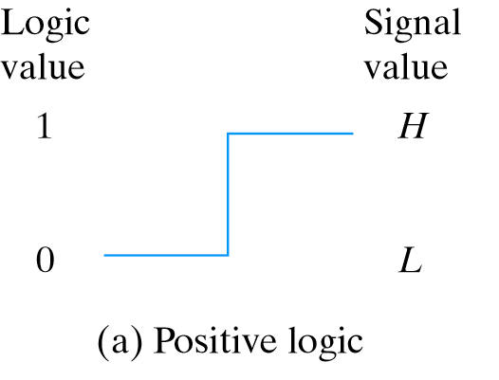

Positive and Negative Logic
Positive and Negative Logic
Two signal values <=> two logic values
Positive logic: H=1; L=0
Negative logic: H=0; L=1

Slide 60
Syllabus
Chapter 2 (Excluding Section 2.9)

